Slide 1
Parallel Computing
Inverse Kinematics Solver
Midterm Report
電機碩 陳昕佑 61375017H

Slide 2
Project Description
Goal:
Implement a brute-force inverse kinematics (IK) solver for a 6-DOF robotic arm.
Compare single-thread, Pthreads, and OpenMP implementations.
Scope:
Solve IK for a batch of waypoints (initially 3, then 1000).
Measure computation time for each approach.

Slide 3
Inverse Kinematics & Parallel Computing
Inverse Kinematics (IK):
Definition: Finding joint angles that achieve a desired end-effector position(x, y, z).
Brute-force approach: Randomly sample joint angles, pick the set minimizing distance to target. (Simple but inefficient.)
Parallel Computing:
Pthreads: C API for creating and managing threads directly.
OpenMP: Compiler-based approach (#pragma omp) for parallelizing loops.
Why Parallel?: Potential to reduce computation time if the work is large (e.g., big batch of waypoints).

Slide 4
Experimental Steps & Methodology
Generate Waypoints
Create a list of random 3D targets.
Single-Thread Implementation
Sequentially solve brute-force IK for each waypoint.
Pthreads Implementation
Create a fixed number of threads (e.g., 4).
Divide the 1000 waypoints among the threads (chunking).
Each thread solves IK for its subset.
OpenMP Implementation
Use #pragma omp parallel for to distribute waypoints across threads automatically.
Measurement
Record the total runtime for each implementation.
Compare times.

Slide 5
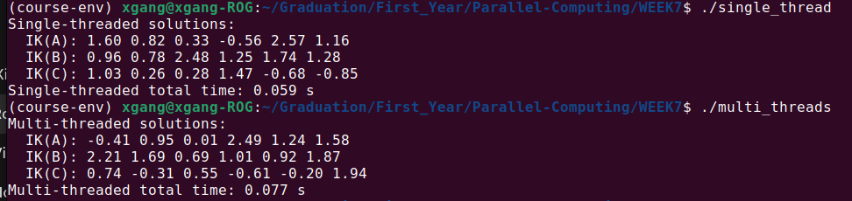
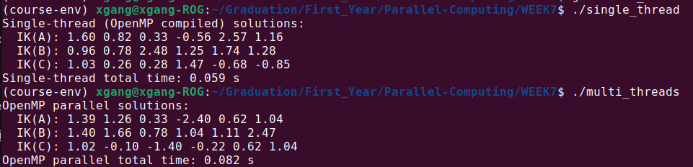
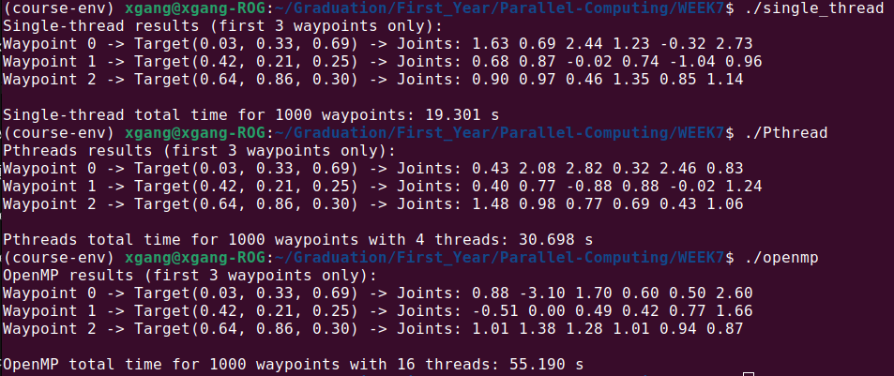
Comparison between
Single Thread & Pthread
Comparison between
Single Thread & OpenMP
Comparison between
Single Thread
Pthread
OpenMP
(1000 waypoints)

Slide 6
Problems Encountered
Thread Overhead & Synchronization
Creating/joining threads, especially for small tasks, can add overhead.
rand() Contention
Standard C library rand() uses shared state, causing bottlenecks in parallel runs.
CPU Frequency Scaling
Many-thread scenarios can lower CPU clock frequency due to thermal/power constraints.
Brute-Force Inefficiency
Random sampling is so heavy that overhead + contention can outweigh parallel gains.
Observation
Single-thread might be faster if overhead is too large.
With certain optimizations (fewer threads, better random generation), parallel can outperform single-thread on large problems.
Pthread method is a little bit faster than OpenMP.

Slide 7
Conclusions & Future Work
Conclusions
Brute-Force IK is very costly and can negate parallel gains if not done carefully.
Thread Overhead + rand() contention often made parallel runs slower than single-thread for these tests.
Large Enough Work and Optimized Random or Better Solvers are needed to truly leverage multicore.
Future Work
Use a numerical or analytical IK solver to drastically reduce computations.
Employ thread-local PRNG or other lock-free random generation.
Experiment with different chunk sizes or different thread counts for better scaling.

Slide 8
Thank You

